Slide 1
2018 Annual
Bilingual/ESL Conference
William Paterson University
Presenter: Dr. Mary Bonitatibus-Garrity

Slide 2
Teaching Grammar in the
ESL Classroom via
Google Suite Applications

Slide 3
What we will cover today…
Introduction to and setting up a Google Classroom
  Adding Co-Teacher and/or Students
Creating an Assignment, Quiz Assignment, Announcement or provide instructional material
Using Google Docs
  Lesson planning, providing student feedback & grading
Using Google Forms
  Creating an assessment & uploading scores to the Classroom or exporting to a Google Sheet
Using Google Sheets
  Scoring assessments & viewing data

Slide 4
Introduction to Google Classroom
Open Google
Login to your Google Account
  From the Apps button select Classroom (if not visible search for Classroom)
Join my class by clicking on the + sign on the top right, select student (for today), enter my class code:
Class code: 4wor17i

Slide 5
Setting up/Creating Your Own Classroom
NOTE: You will need an Education/G-Suite type of account to create a classroom for students.
  For today, simply select that you are not creating a Classroom for students
Indicate you are a teacher
Select the + sign to add a course: complete pertinent information
Select PEOPLE from the three tabs across the top
  Select the + sign for Teacher or Students to invite people, or
  Provide people with your class code.

Slide 6
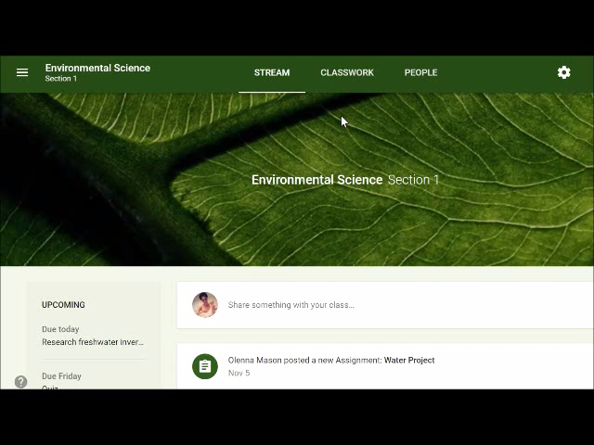
Creating an Assignment in Google Classroom
You can add to your classroom:
  Assignments
  Quiz
  Questions
  Material

Slide 7
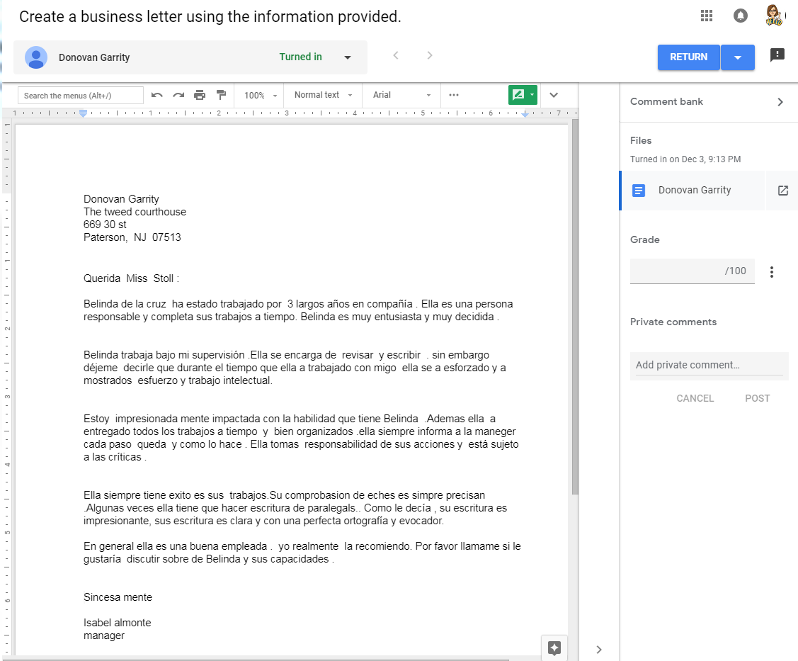
Using Google Docs: Feedback & Grading
Assignment
Status
Turn on Comments
Comment bank
Open in new window
Grade assignment
Change total points in Classroom
Send private comment to student

Slide 8
Using Google Forms
Creating an assessment
Uploading scores to Google Classroom, or
Exporting to a Google Sheet
Add-ons: Ex. Flubaroo (grading app)

Slide 9
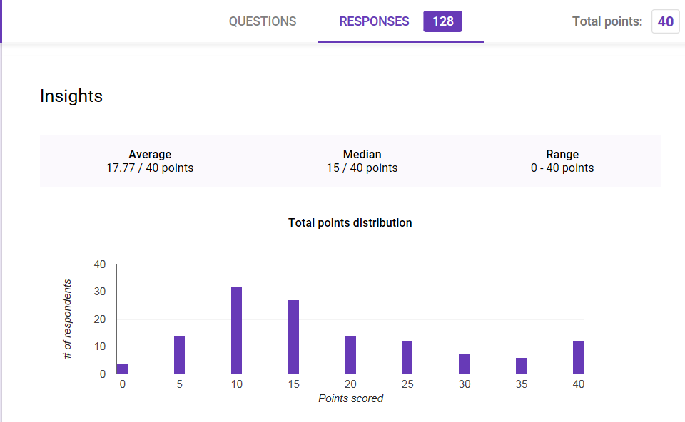
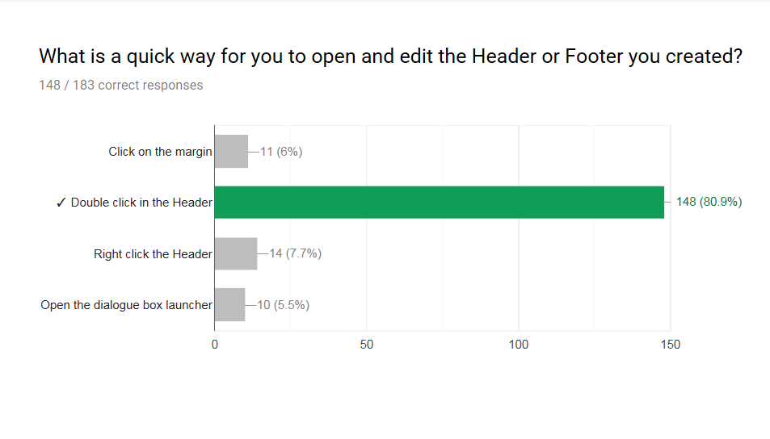
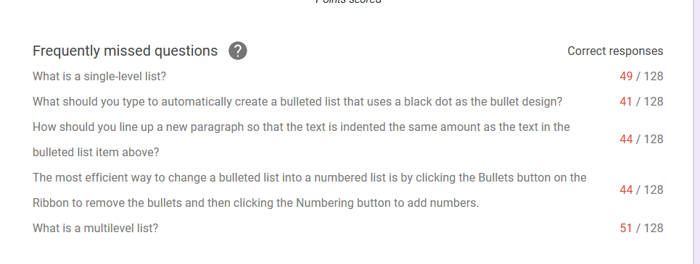
Using Data to Inform Instruction
View the responses in Google Forms as Charts: Analyze, review, or re-teach

Slide 10
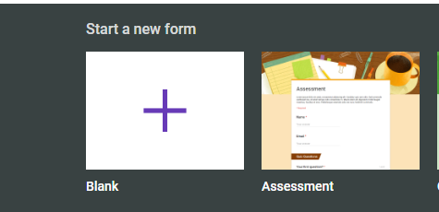
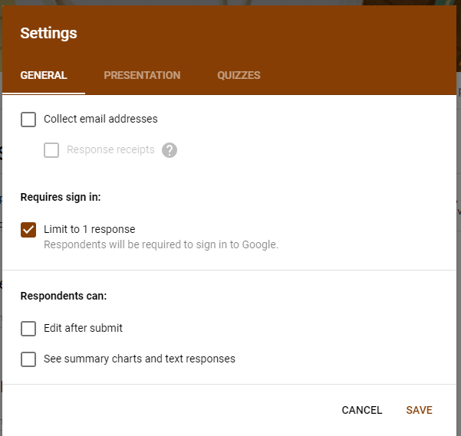
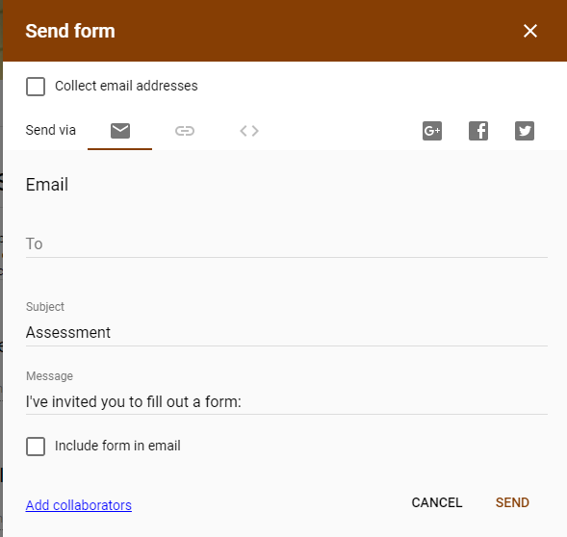
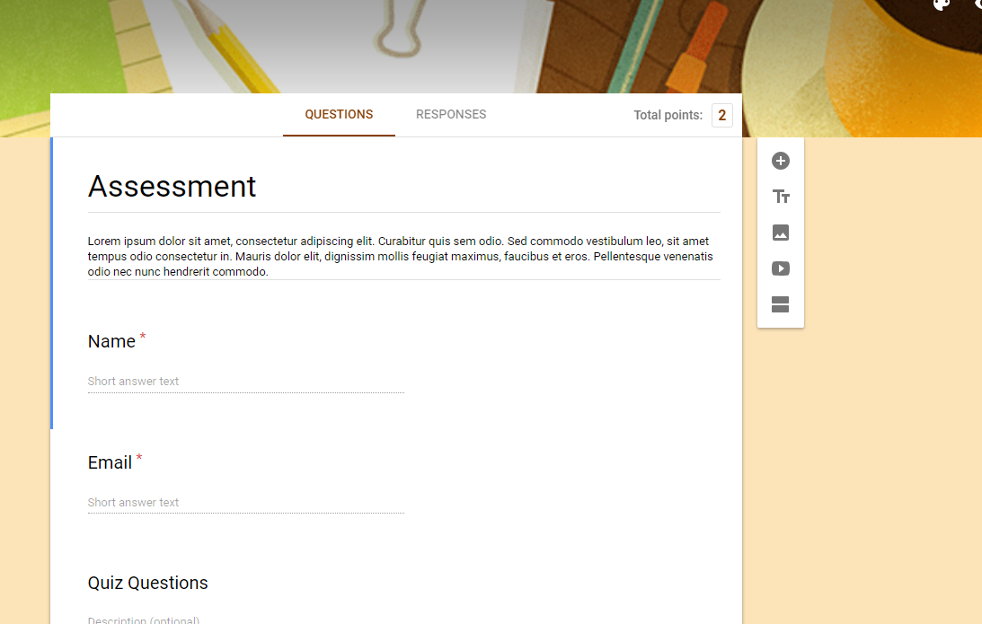
Creating an Assessment

Slide 11
Add-ons: Ex. Flubaroo (grading app)
Flubaroo: http://www.flubaroo.com/instructional-videos
Joe Zoe Express: https://getjoezoo.com/how-it-works.html

Slide 12
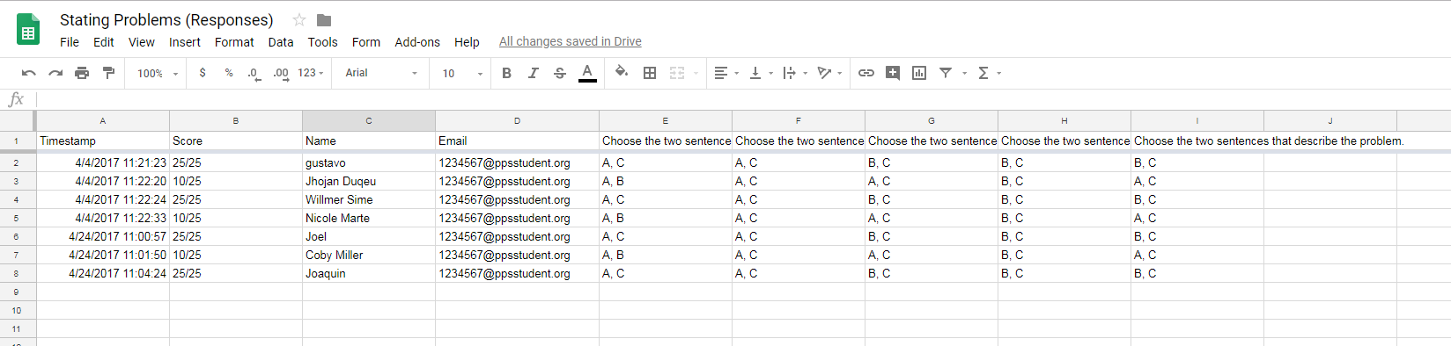
Using Google Sheets: Scoring & Viewing data
Stating Problems Responses

Slide 13
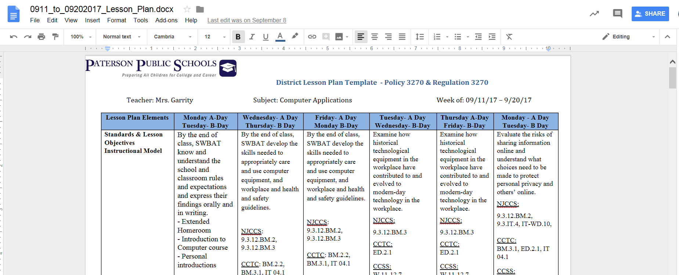
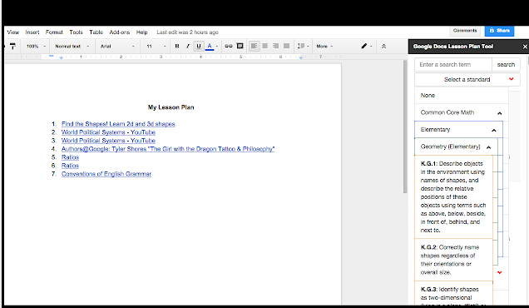
Google Docs – Lesson Plan Tools

Slide 14
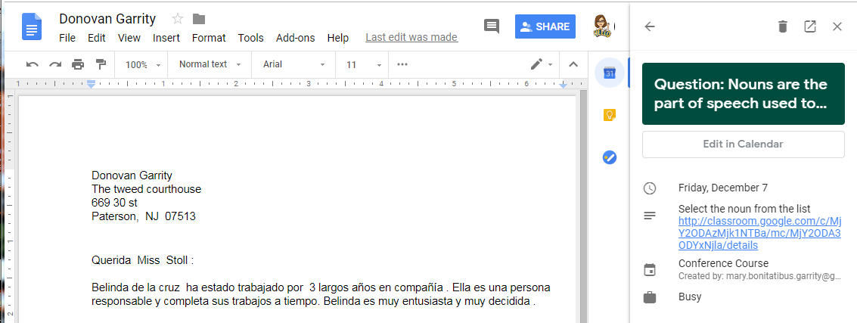
Supplemental Info – New Window/Calendar

Slide 15
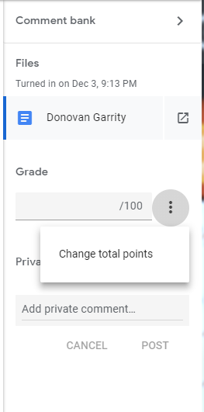
Supplemental Info – Points

Slide 16
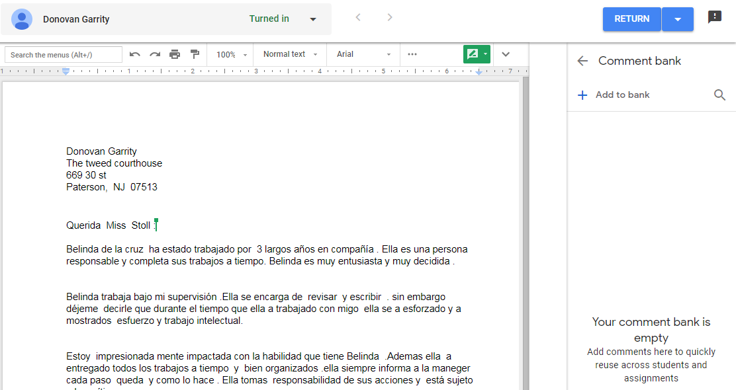
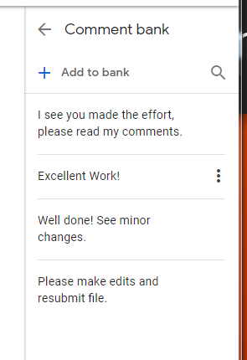
Supplemental Info – Comment Bank

Slide 17
Thank you!
If you have any questions, please contact me at:
Dr. Mary Bonitatibus-Garrity
Marybono23@aol.com

